Slide 1



G H RAISONI INSTITUTE OF ENGINEERING AND TECHNOLOGY, NAGPUR
(Approved by AICTE, New Delhi and Recognized by DTE, Maharashtra)
An Autonomous Institute Affiliated to Rashtrasant Tukadoji Maharaj Nagpur University, Nagpur
Accredited by NAAC with A+ Grade
Department of Computer Science & Engineering
External Seminar
On
MyVote : Blockchain Based
Voting Application
Guide:
Dr. Sonali Ridhorkar
Name of Projectees:
Monal Wanjari Shamsul Husain Ansari Pankaj Sonwane
Session 2022-23

Slide 2
Contents
Introduction
Literature Survey
Objective of Project
Flow chart /Block Diagram
Innovative work
Modules
Work done (till date)
Result & Discussion (till date)
Work plan
References

Slide 3
Introduction
Elections are the important thing for any democratic country, that’s why it becomes necessary to ensure that no tampering should happen with the votes. Currently there are two systems are mostly used in India for voting which are Ballot Papers and Electronic Voting Machines (EVMs).
Both the Ballot Paper and EVM are not much secured and safe way for voting as both have some discrepancies. And the government invest lot of money on elections which is not good.
“MyVote” will be an android application which will be used for voting in elections. It will be based on Blockchain Technology so that the security can be maintained and there will be very less chance of tampering with the votes.
The application will first authenticate the voter by their Aadhar number and OTP. And further process will be proctored to ensure that no one is forcing the voter to vote to any particular candidate.

Slide 4
Literature Survey
Sr. No. | Paper Title and its Author | Details of Publication | Findings
1 | Aadhaar Base Voting System Using Blockchain Technology - Ms. Sayali B. Khatal , Ms. Vaishnavi R. Musmade , Ms. Trupti A. Waman , Ms. Shubhada B. Shinde | IJSDR, ISSN: 2455-2631, pp. 161-163, Volume 6, Issue 5, Jan 2022. | Blockchain accepts a huge part in the e-projecting a voting form system which ensures the security of votes by preventing change of data set aside in blocks using the cryptographic technique. Aadhar fuse to the e-voting system vanquishes the duplication or modifying of votes.
2 | Blockchain-based E-Voting Technology: Opportunities and Challenges - P. Khanpara, S. Patel and S. Valiveti | 2022 7th International Conference on Communication and Electronics Systems (ICCES), 2022, pp. 855-861. | The voting system is mostly based on a centralized system. As a result, there are many chances of risks like vote tampering, security, transparencies, DoS attacks and many more. Due to these problems, the population of the world, is not fully trusting the voting system.

Slide 5
Literature Survey
Sr. No. | Paper Title and its Author | Details of Publication | Findings
3 | Biometric Based Voting System Using Aadhar Database - G. Deepa, Balambigai Subramania, A. Vennila, T. C. Kalaiselvi. | 2022 Second International Conference on Artificial Intelligence and Smart Energy (ICAIS), 2022, pp. 1071-1075 | The details of the voters are stored as database. While voting, the fingerprint is registered to fetch the stored details such as name, age voter ID, place of the voter. Then, the Aadhar number is given to enable the EVM to cast the vote against the desired candidates. This method reduces chance of hacking and rigging.
4 | A Two-Phase Authentication Mechanism for E-voting in India - Dr. Maya Rathore | IJRES, ISSN No. 2320 – 9364, Vol.10, Issue 4, pp. 26 – 31, April 2022. | In this paper, a two phase authentication mechanism is proposed which uses both unique identification number (i.e. AADHAR number) along with One Time Password (OTP) send on registered mobile number. At the time of voting in the elections, the voter authentication can be done through both aadhar number as well as registered mobile number

Slide 6
Objectives of the Project
The Voter will be verified first by their Aadhar Card No. and will be authenticated by the OTP or the biometrics. the further process will be proctored to ensure that no one is forcing the voter to vote for the particular candidate.
There will be also an option for helpline, if someone tries to force or misbehaves with the voter, the voter can used that option in such situation. a alert will be instantly send to the nearest police station.
The e-voting system should not allow access to invalid candidates, and every voter should get only a single chance to vote.
It should provide complete privacy to voters.

Slide 7
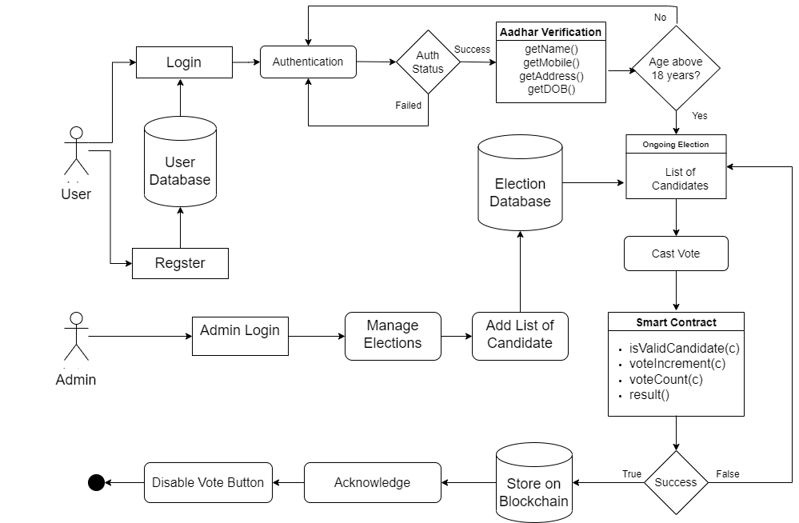
Flow Chart / Block Diagram

Slide 8
Modules
Login:- The Login must be required for any user by their mobile number in order to use the MyVote System. The user’s Mobile number will be verified by sending the SMS on the user’s mobile number.
Aadhar Authentication:- The Voter’s Aadhar will be verified by the otp that will be sent on the voter’s aadhar linked mobile number. The details of the voter will be automatically fetched from the UIDAI’s Database and if the Voter’s age is above 18 then only he/she will be allow to vote. The address of the voter will also be fetched and according to voter’s address the ongoing elections list will be displayed.
Proctoring:- The Voting Process will be proctored that means the camera and mic will be on to track any kind of suspicious behavior with the user.
Vote Casting:- The Voter can select the particular candidate which he want to give the vote. The voter can vote for only once after that the voting button will be disabled. After successfully casting the vote by the voter the vote will be stored on Blockchain to keep the record of the votes secured.

Slide 9
Work done (till date)
Tools & Technology:
Solidity: Solidity is an object-oriented programming language created specifically by the Ethereum Network team for constructing and designing smart contracts on Blockchain platforms. It's used to create smart contracts that implement business logic and generate a chain of transaction records in the blockchain system.
Ganache: Ganache is a private Ethereum blockchain environment that allows to you emulate the Ethereum blockchain so that you can interact with smart contracts in your own private blockchain.
Metamask: MetaMask is a software cryptocurrency wallet used to interact with the Ethereum blockchain. It allows users to access their Ethereum wallet through a browser extension or mobile app, which can then be used to interact with decentralized applications.
Firebase: Google Firebase is a Google-backed application development software that enables developers to develop iOS, Android and Web apps. Firebase provides tools for tracking analytics, reporting and fixing app crashes, creating marketing and product experiment.

Slide 10
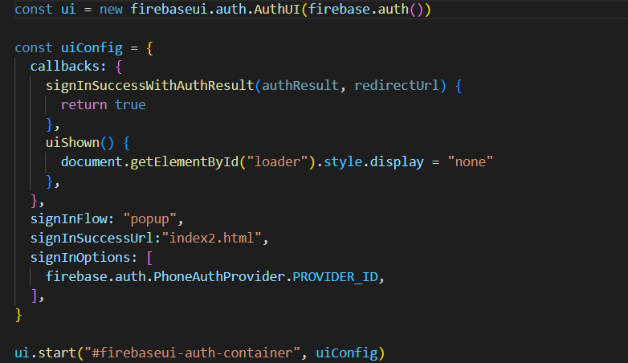
Work done (till date)
Implemented Phone Authentication using firebase phone authentication functionality

Slide 11
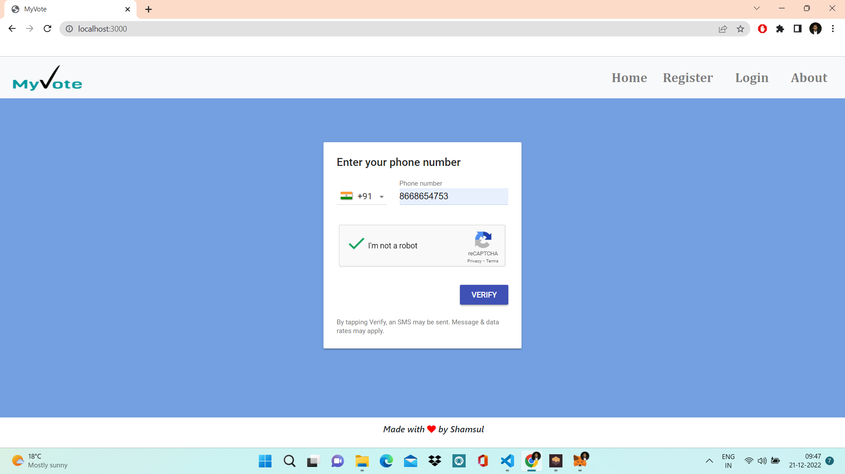
Work done (till date)
Phone Authentication via Mobile Number

Slide 12
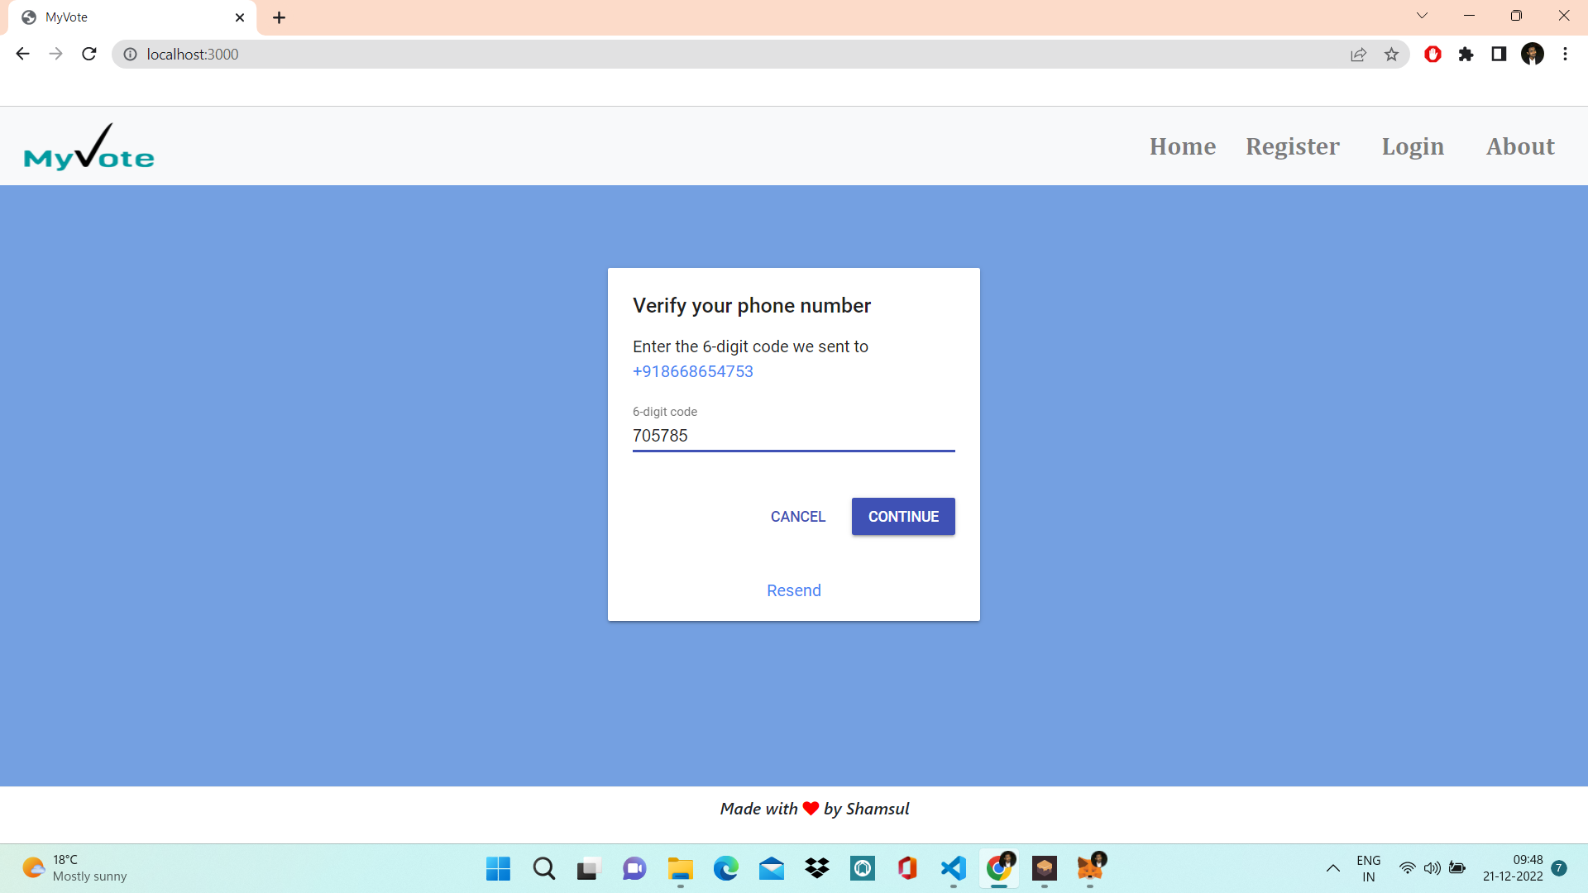
Work done (till date)
OTP Verification

Slide 13
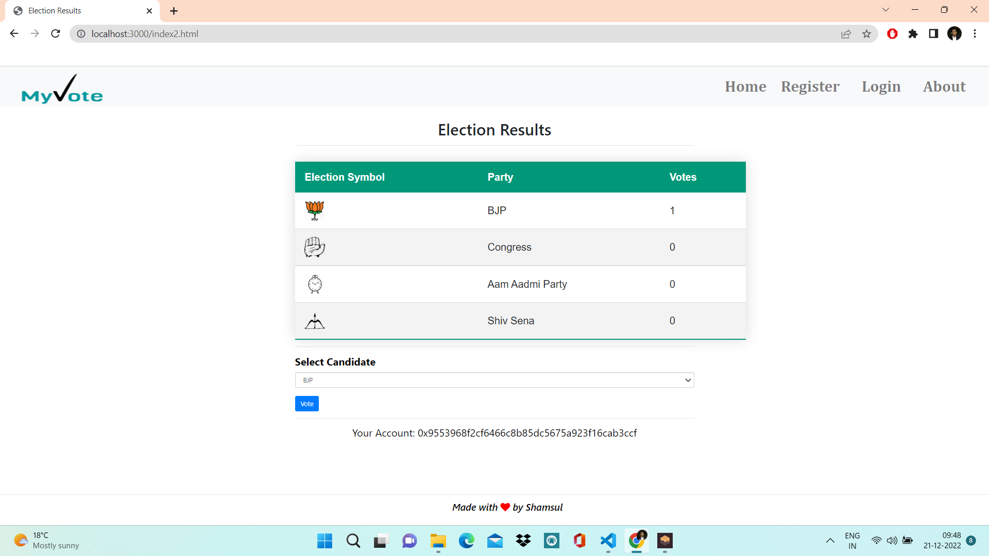
Work done (till date)
Voting Page

Slide 14
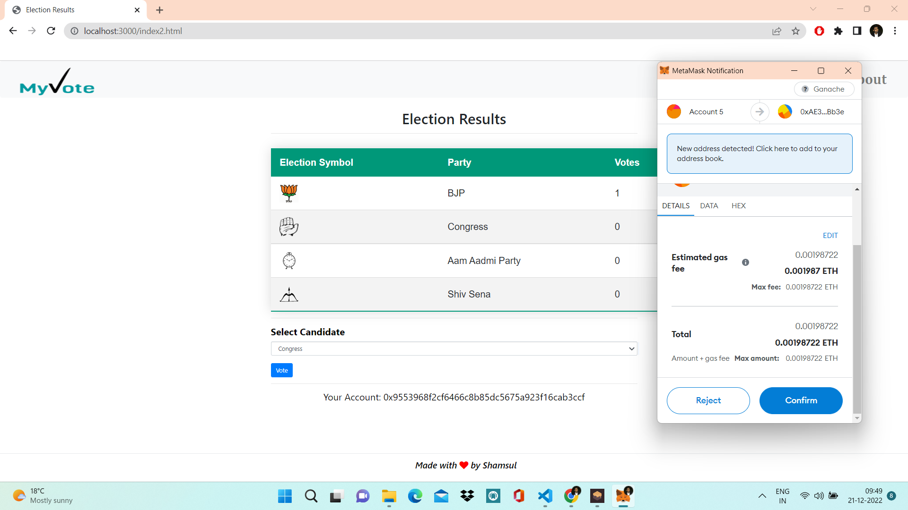
Work done (till date)
Ethereum Transaction to cast the vote with the help of Metamask

Slide 15
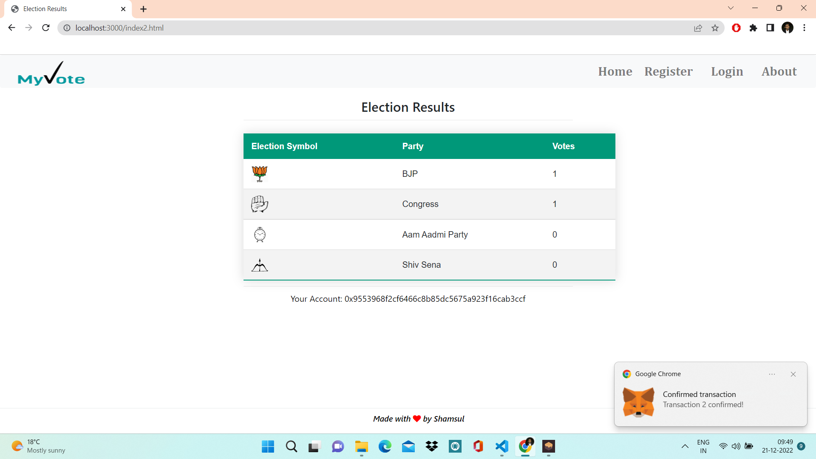
Work done (till date)
Vote Casted Successfully

Slide 16
Result & Discussion (till date)
The Votes will be stored on a blockchain so, there will be very less chance of hacking or tampering with the votes.
As the data of the voting will be stored on a distributed server. So, there will be no control will be in hands of any single authority. That’s why the chances of corruption can become less.
There will be no need of Voter ID Card to cast the vote. As the system can directly verify the user by their Aadhar Card No. and identifies that the user is able to vote or not by their age.
This System will be more effective than currently available voting system and will be much more secured.
The Cost that government invest on organizing the elections will be reduced.

Slide 17
Result & Discussion (till date)
The Votes are stored on the blockchain so, there are very less chance of hacking or tampering with the votes.
As the data of the voting will be stored on a distributed server. So, there will be no control will be in hands of any single authority. That’s why the chances of corruption will become less.
Login is done with the help of Phone authentication.
Votes are casted with the help of Ethereum transaction.

Slide 18
Work – Plan
Months Activities | JUL’22 | AUG’22 | SEPT’22 | OCT’22 | NOV’22
Literature Reviews | √ | √
Component Identification & Selection | √ | √
Designing |  | √ | √
Experimental Analysis |  |  | √ | √
Testing and Debugging |  |  | √ | √
Preparation of Project Report |  |  | √ | √
Submission of Thesis |  |  |  |  | √

Slide 19
References
Research Papers:
Ms. Sayali B. Khatal, Ms. Vaishnavi R. Musmade , Ms. Trupti A. Waman , Ms. Shubhada B. Shinde – “Aadhaar Base Voting System Using Blockchain Technology”, “International Journal of Scientific Development and Research (IJSDR)”, ISSN: 2455-2631, pp. 161-163, Volume 6, Issue 5, Jan 2022.
Dr. Maya Rathore, “A Two-Phase Authentication Mechanism for E-voting in India”, “International Journal of Research in Engineering and Science (IJRES)”, ISSN (Online): 2320-9364, Volume 10 Issue 4, PP. 26-31, April 2022
Sadia, K.; Masuduzzaman, M.; Paul, R.K.; Islam, A. Blockchain-based secure e-voting with the assistance of smart contract. In IC-BCT 2019; Springer: Berlin/Heidelberg, Germany, 2020; pp. 161–176.
S. Shukla, A. N. Thasmiya, D. O. Shashank and H. R. Mamatha, "Online Voting Application Using Ethereum Blockchain," 2018 International Conference on Advances in Computing, Communications and Informatics (ICACCI), Bangalore, 2018, pp. 873-880
R. T M and R. Sumathi, "Electronic Voting based on Virtual ID of Aadhar using Blockchain Technology," 2020 2nd International Conference on Innovative Mechanisms for Industry Applications (ICIMIA), Bangalore, India, 2020, pp. 71-75.

Slide 20
References
Conference Papers:
P. Khanpara, S. Patel and S. Valiveti – “Blockchain-based E-Voting Technology: Opportunities and Challenges”, “2022 7th International Conference on Communication and Electronics Systems (ICCES)”, 2022, pp. 855-861.
G. Deepa, Balambigai Subramania, A. Vennila, T. C. Kalaiselvi - 2022 Second International Conference on Artificial Intelligence and Smart Energy (ICAIS), 2022, pp. 1071-1075.
Benny, Albin, Blockchain based E-voting System (July 11, 2020). Available at SSRN: https://ssrn.com/abstract=3648870 or http://dx.doi.org/10.2139/ssrn.3648870
R. Hanifatunnisa and B. Rahardjo, "Blockchain based e-voting recording system design," 2017 11th International Conference on Telecommunication Systems Services and Applications (TSSA), 2017, pp. 1-6, doi: 10.1109/TSSA.2017.8272896.

Slide 21
Thank you !

